Slide 1
HR Workforce Analytics Dashboard
Power BI Portfolio Project Prepared by: Camron Gayle Tools Used: Power BI • Power Query • DAX • Excel • GitHub

Slide 2
Business Problem
Organizations need timely workforce insights to understand employee turnover, workforce demographics, and employee satisfaction.
Manual reporting can make it difficult to identify trends and support strategic HR decisions.
This dashboard centralizes workforce data into an interactive report that helps HR teams monitor employee metrics and identify areas for improvement.

Slide 3
Dataset & Tools
Dataset
IBM HR Analytics Employee Attrition Dataset
Human Resources industry
1,470 employee records
35 employee attributes
Tools
Power BI
Power Query
DAX
Excel
GitHub
Data Preparation
Verified data types
Removed unnecessary columns
Created DAX measures
Built KPI calculations

Slide 4
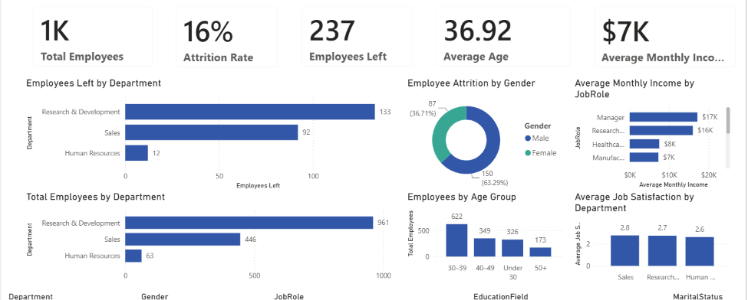

Dashboard Overview
Key features include:
KPI cards for workforce metrics
Department-level employee analysis
Attrition analysis
Salary comparisons
Job satisfaction insights
Interactive slicers for filtering data

Slide 5
Key Insights
Sales experienced the highest employee attrition.
Research & Development had the largest workforce
.Employees with fewer years at the company showed higher turnover.
Lower job satisfaction was associated with increased attrition.
Average monthly income varied significantly across job roles.

Slide 6
Business Recommendations
Improve onboarding for new employees.
Focus retention efforts on high-turnover departments.
Increase employee engagement initiatives.
Review compensation for critical job roles.
Monitor workforce metrics regularly using interactive dashboards.

Slide 7
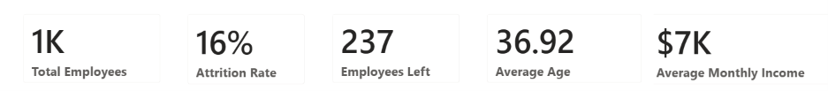
Business Impact
Reduce employee turnover through targeted retention strategies.
Improve HR reporting efficiency with automated dashboards.
Increase visibility into workforce trends.
Support better workforce planning and data-driven decision-making.

Slide 8
Skills Demonstrated
Technical Skills
Power BI
Power Query
DAX
Excel
GitHub
Analytics Skills
Data Cleaning
KPI Development
Dashboard Design
Data Visualization
Business Intelligence
Workforce Analytics
Problem Solving
Stakeholder Communication
Thank You!

